Slide 1
High Stakes Testing:
Is it Worth the Costs?
A Presentation Created by the
VOICE Education Action Team

Slide 2
Recent Headlines
“Significant amount of schools receive D’s and F’s”
-KFOR.com
“Dropout rates double at Oklahoma City Public Schools.”
-KOCO.com
“New state law will hold third graders back for reading deficiencies.”
-OKCFox.com

Slide 3
Where does high the stakes testing culture come from?

Slide 4

No Child Left Behind (NCLB) History
Sandy Kress
  -Dallas County Democratic Party
  -Dallas ISD School Board
  -Partnership with George W. Bush
  -TAAS and McGraw-Hill
  -NCLB

Slide 5
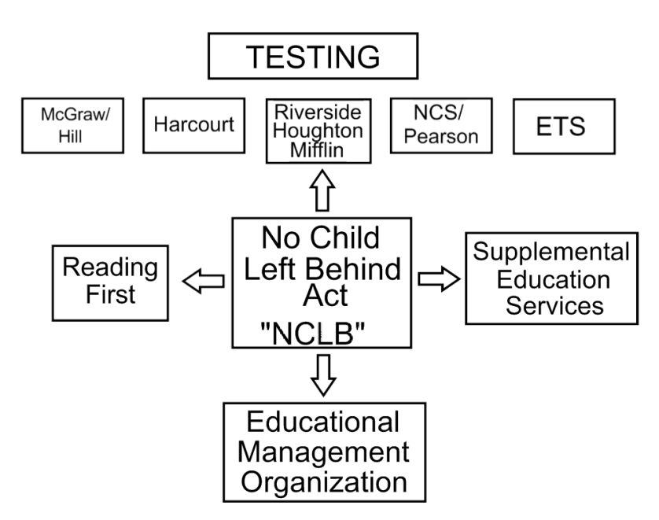
$

Slide 6
Oklahoma is now entrenched
in a testing culture
Number of tests students are REQUIRED to take during their
K-12 career.
The high-stakes nature of the tests
The A-F letter grades given to schools based on these tests.

Slide 7
Testing in Oklahoma
During a student’s career K-12, s/he will take no fewer than 28 mandated high stakes assessments and could take as many as 46.
Additionally, benchmark tests are given four times annually in all grades in most districts.

Slide 8
Third Grade Reading Law
“Beginning with the 2011-2012 school year, if the reading deficiency of a student, as identified based on assessments administered…is not remediated by the end of third grade, as demonstrated by scoring at the unsatisfactory level on the reading portion of the statewide third-grade criterion-referenced test, the student shall be retained in third grade.”
Oklahoma Reading Sufficiency Act
RSA-70-1210

Slide 9
Reading Sufficiency Act Funding
Budget in millions
$30
$25
$20
$15
$10
$5
$0
FY11 FY12 FY13 FY14 Florida
equivalent
Notes:
According to the Oklahoma Policy Institute, Oklahoma’s third-grade retention requirement was modeled after a similar law in Florida. However, a program equivalent to Florida’s successful program would cost Oklahoma $31 million, five times more than what has ever been funded by the Reading Sufficiency Act. In fact, for the past 2 years, Oklahoma has defunded the Reading Sufficiency Act entirely

Slide 10
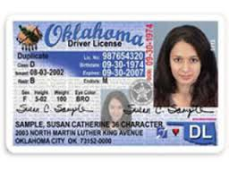
Other High Stakes for Students:
Eighth grade reading test failure:
no driver’s license
End-of-Instruction tests:
Must pass 4 of 7 to graduate
Algebra I Algebra II Geometry English II
English III Biology US History

Slide 11
Current Drop-Out Rates

Slide 12
Impact of Testing
On Students
On Teachers
On Schools

Slide 13
Psychological affects on students
Increased discipline referrals during six-week testing window.

Slide 14
Impact on Students
Decreased quality instruction time
173 vs. 125

Slide 15
Test Results
Tests are taken in April and early May yet final scores are not released to schools until September or October.
Compare this timeline to other tests that are administered across the country:

Slide 16
Assessment | Total Time | Receipt of Results
ACT Exam | 3 hours, 25 minutes | 3-8 weeks
SAT Exam | 3 hours, 20 minutes | 3 weeks
GRE (Graduate Record Exam) | 2 hours, 50 minutes | 3-6 weeks
NCLEX-RN (National Council Licensure Exam for Reg. Nurses) | Maximum of 6 hours | Preliminary results: 48 hrs Final results in one month
Commercial Pilot Exam | 3 hours | 1-2 weeks
MCAT (Medical College Admission Examination) | 4 hours, 5 minutes | 4-5 weeks
Oklahoma Bar Exam | 2 days | 7 weeks
Average 8th Grader in 2015 | 12 hours (nine tests over 4 days) | 4-5 months

Slide 17
Teachers leaving the profession
One-third of new teachers leave the profession within the first 3 years.
Almost 50% leave within 5 years.

Slide 18
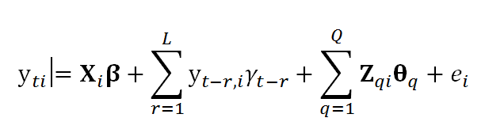
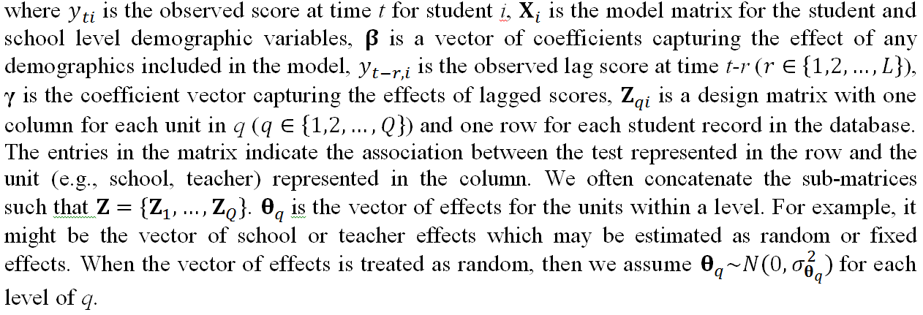
Value Added Measures:

Slide 19
Grading Schools
A-F School grades are now comprised of 100% test results.
Changes in grading laws caused
Oklahoma City Public Schools 1 39
Tulsa Public Schools 8 36

Slide 20
School Performance Grades
Overall school performance grades are based on a combination of four criteria:
1. Student achievement scores (50%)
2. Annual learning gains (25%)
3. Improvement of lowest 25% (25%)
4. Whole school improvement (Bonus Pts)

Slide 21
Grading Schools
A recent OU/OSU study on the A-F grading system identified three main problems:
Small variances in test scores yield significant differences in grades.
Single grades mask school performance.
Performance of low-income students are hidden in high-performing schools.
Notes:
When a school’s raw scores for reading, math and science were averaged, only 3-6 correct responses separated “A” schools from “F” schools on 50-question tests.
A single letter grade does not tell the story on a school’s performance pattern. For example, none of the seven highest performing schools in math received an “A”.
Letter grades hide achievement scores of poor and minority students. In some “A” schools, the minority students performed lower than minority students in some “D” and “F” schools.

Slide 22
Other Impacts
A Florida study found the difference in housing values between a grade of an ‘A’ and a grade of a ‘B’, and a ‘B’ and a ‘C’ was $10,000, holding constant other measures of school quality, neighborhood and property attributes.

Slide 23
A Word About Common Core
The CCSS was a collaborative effort of the National Governors’ Association and the Council of Chief State School Officers in 2009.
The purpose was to create a common set of standards to which all students would be held.
Concerns related to CCSS: cost/number of assessments, technology needed to implement the assessments, and profiteering by testing companies.

Slide 24
VOICE’s
Action Plan
Sept 26-28, 2013: 3-day training
Oct-Nov: Individual Meetings
Dec-March: Presentations/House Meetings
April, 2014: Alternative Grading System
Development
April-May, 2014: Meet with the candidates
June 8, 2014: Accountability Session

Slide 25
For More Information, visit
www.voiceokc.org
Like us on Facebook
Voiceforokc

Slide 26
In Closing…
Share a story about students, schools, testing…
What makes an “A” school?

